Slide 1
K.RAMAKRISHNAN COLLEGE OF ENGINEERING
Team members:
R.dhanya
G.rubapriya
S.varuna
K.harini shree

Slide 2
CRICKET SCORE EVALUATOR
Software for Cricket Score Evaluator that can perform the following operations:
Add the details of the teams
Add the details of the player
Get the number of runs scored
Get the strike rate of the team
The tossing is done

Slide 3
MODULES
Struct: The code uses a struct called "Player" to store information about each player, such as their name, runs scored, balls faced, wickets taken, and other statistics.
Random Number Generation: The code uses the rand() function to generate random numbers for simulating runs scored by players.
Arrays: The code uses arrays to store the names of players for each team and to store the player objects for each team.

Slide 4
Loops: The code uses loops to iterate over the players and simulate the match over multiple overs and balls.
Conditional Statements: The code uses conditional statements to determine the type of score (6, 4, 1, etc.) and update the corresponding statistics for each player.
String Manipulation: The code uses string manipulation functions like strcpy() and strcmp() to copy player names and compare player names for displaying individual player details.

Slide 5
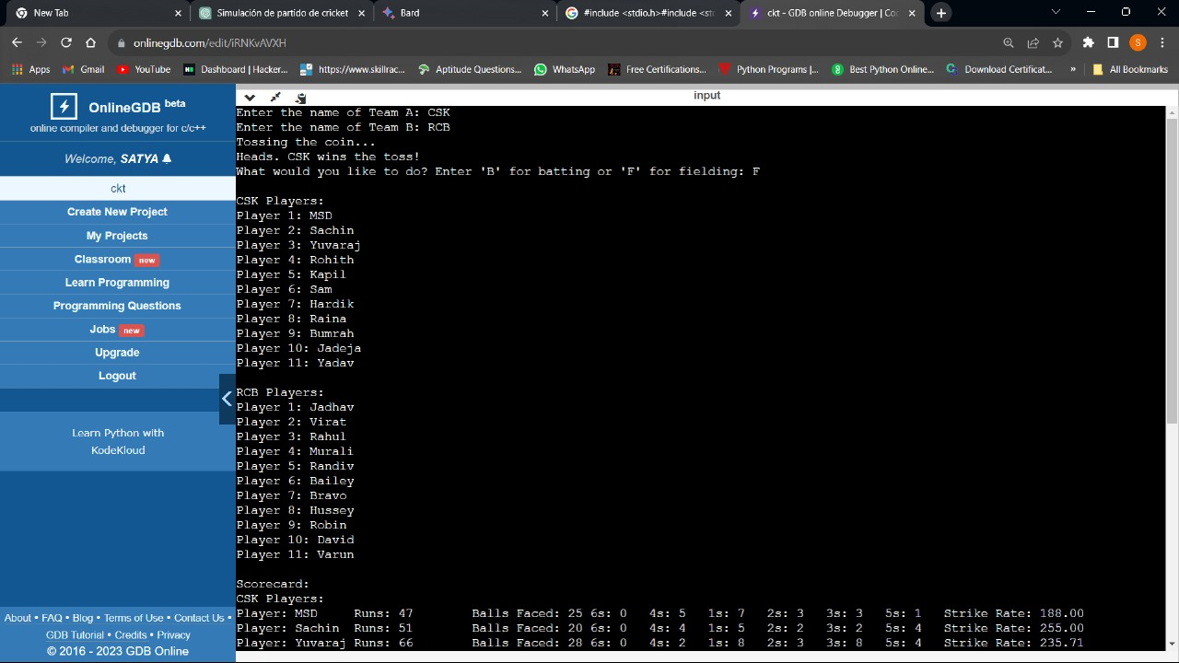
OUTPUT SCREENSHOTS: For Adding the score evaluator:

Slide 6
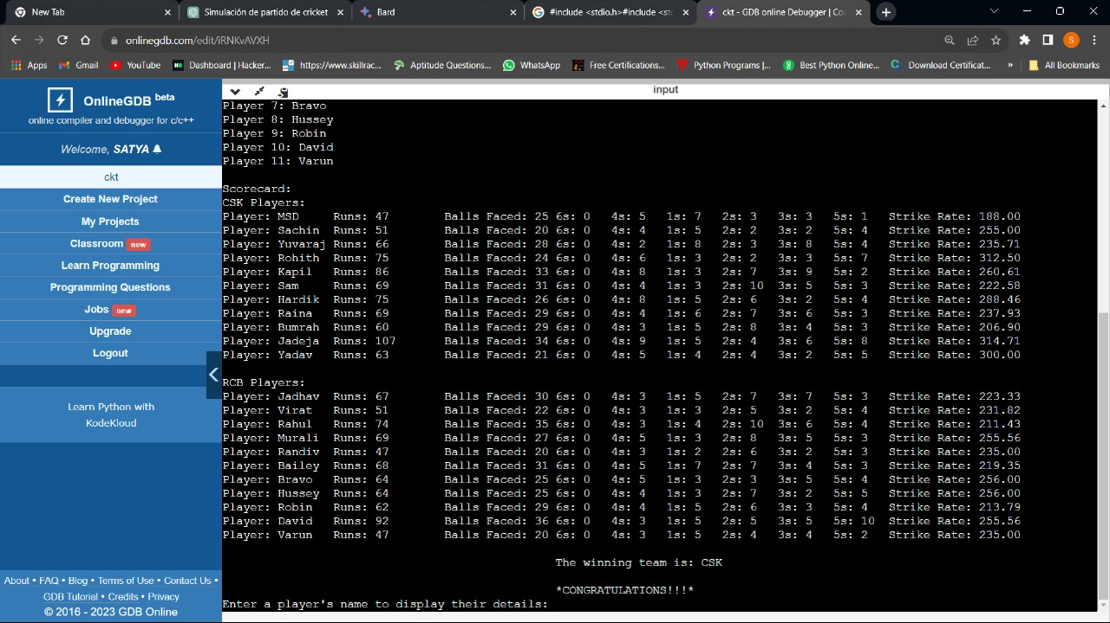
For Eligible Teams:

Slide 7
THANK YOU

